Slide 1
Compact Dual-CP Waveguide Polarizer with a Wire-Grating Dual Feed
Martin Šimák^{1*}, Ding-Bing Lin¹, and Pavel Hazdra²
¹Dept. of Electronic and Computer Engineering, NTUST, Taiwan
²Dept. of Electromagnetic Field, CTU in Prague, Czechia
*Email: martin.simaak@gmail.com

Slide 2
Outline
Introduction
Related work
Polarizer
Dual feed
Simulation results
Conclusion

Slide 3
Introduction
Waveguide-based dual circular polarizer
4.7 GHz to 5.7 GHz (C-band)
Switchable polarization states
Motivation:
Polarization diversity
Compact solution
Manufacturability
Application: Satellite communication

Slide 4
Related work
Dielectric vane polarizers
Wideband operation
High dielectric losses
Iris/corrugated polarizers
Wideband operation
Overmoded structure (mode matching)
Septum polarizers
Dual circular polarization
Complex machining

Slide 5
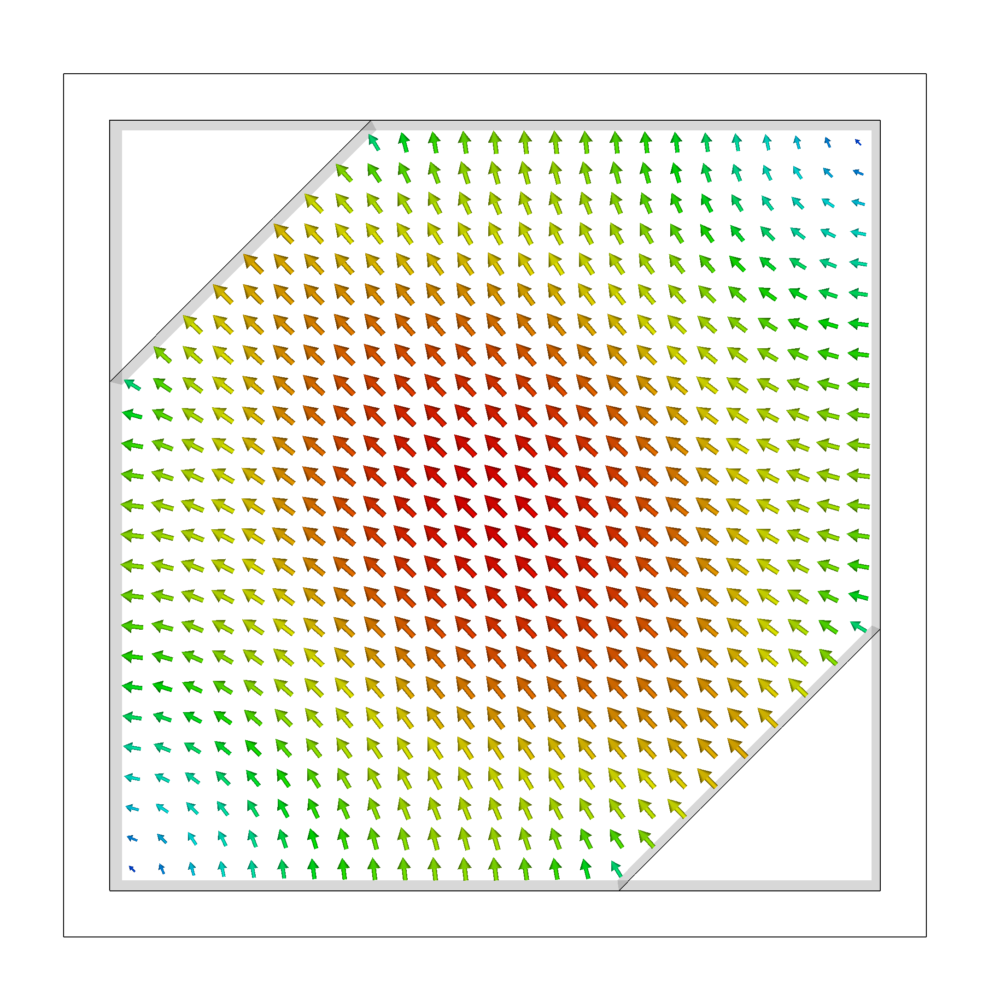
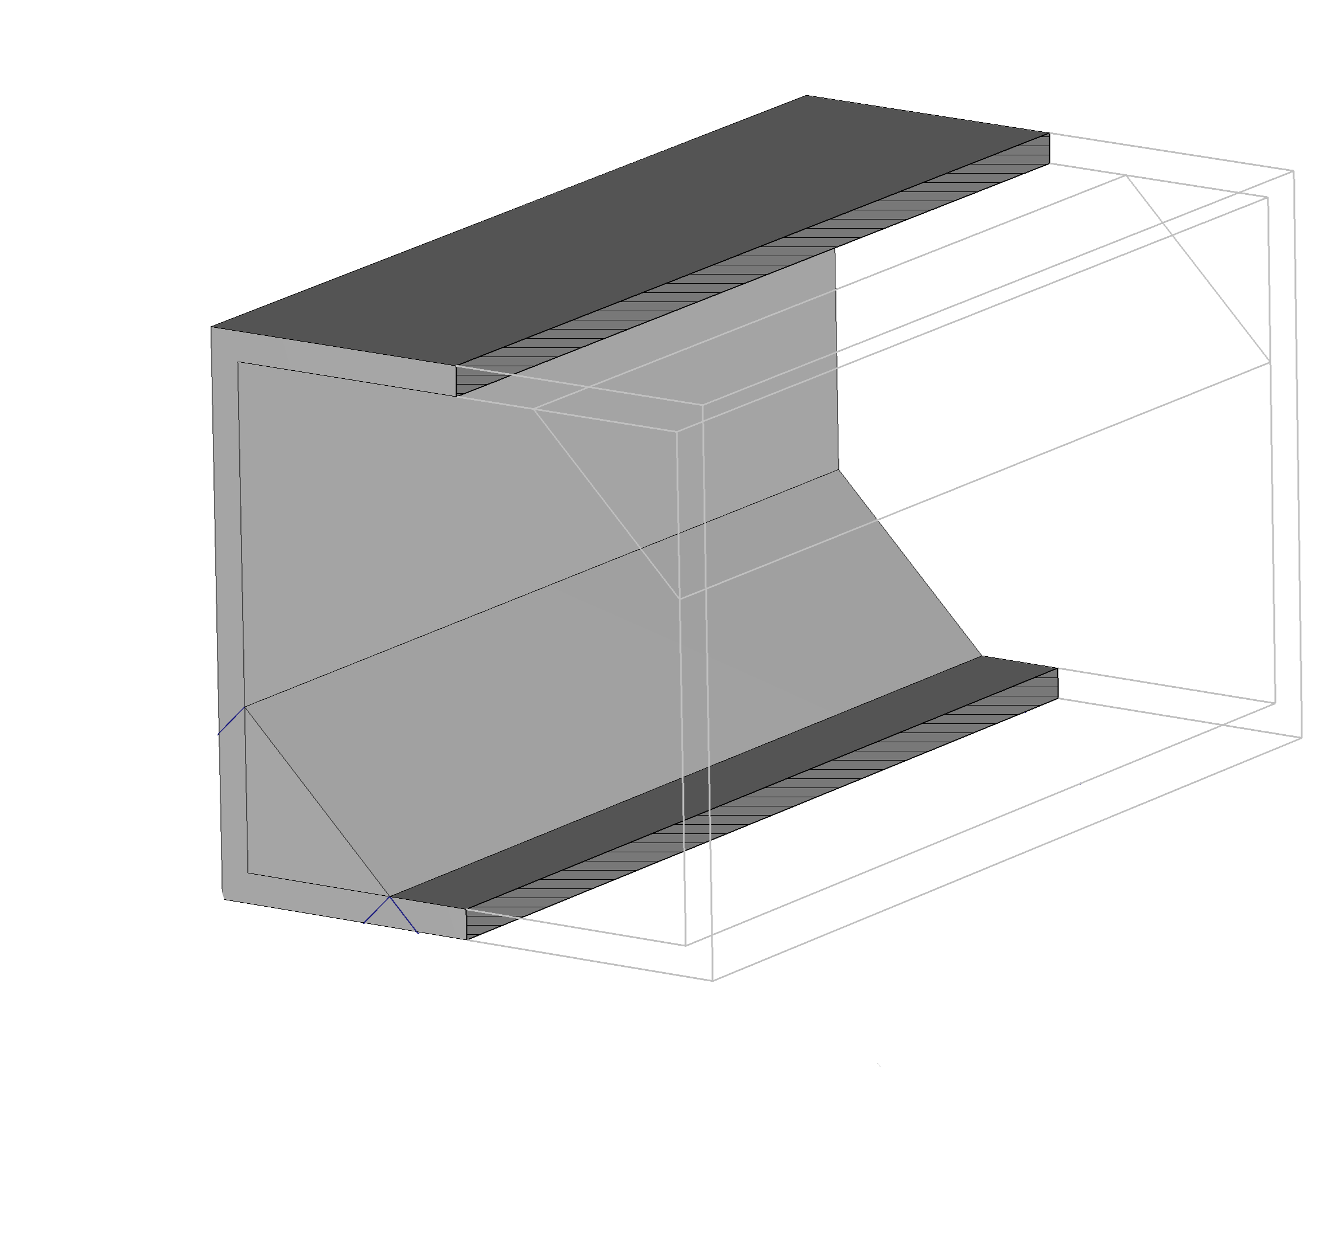
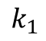
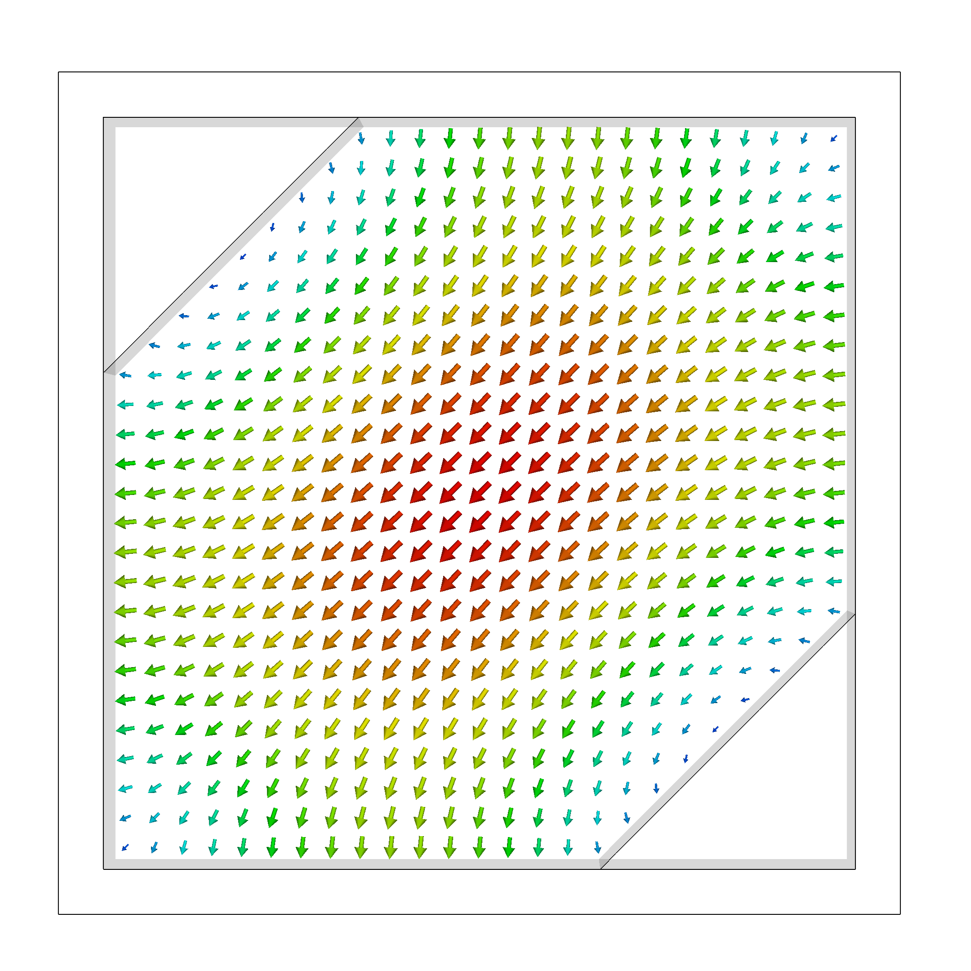
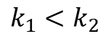
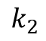
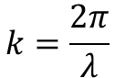
Polarizer: novel approach

Slide 6
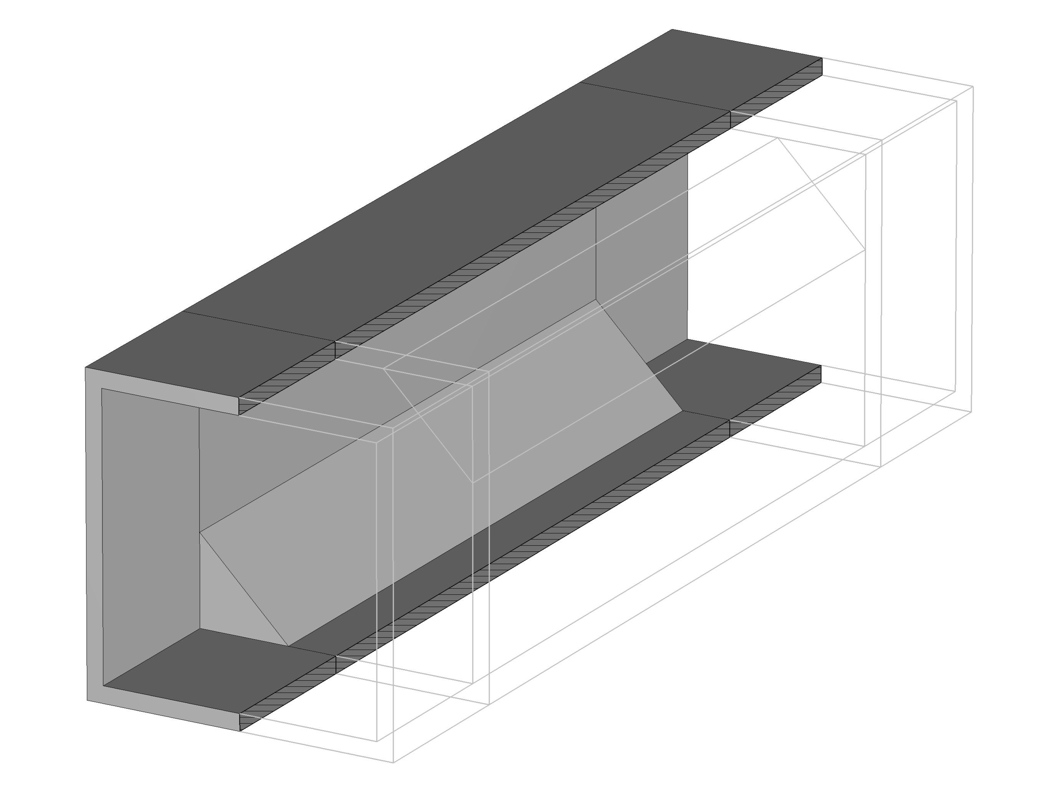
Polarizer: final model

Slide 7
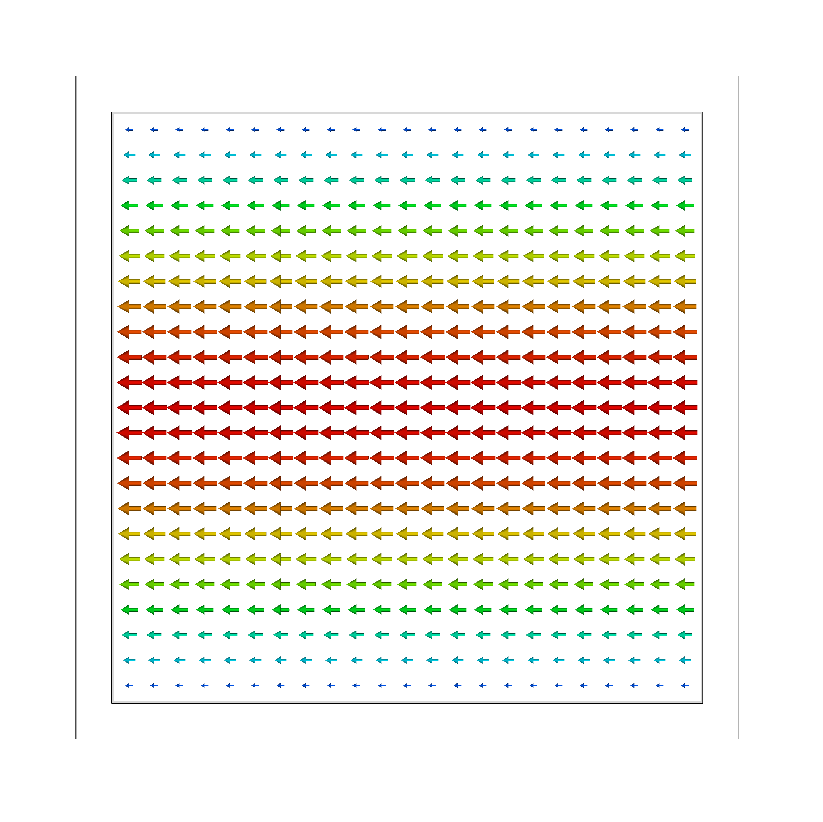
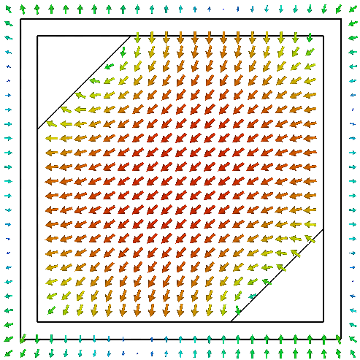
Polarizer: eigenmode analysis

Slide 8
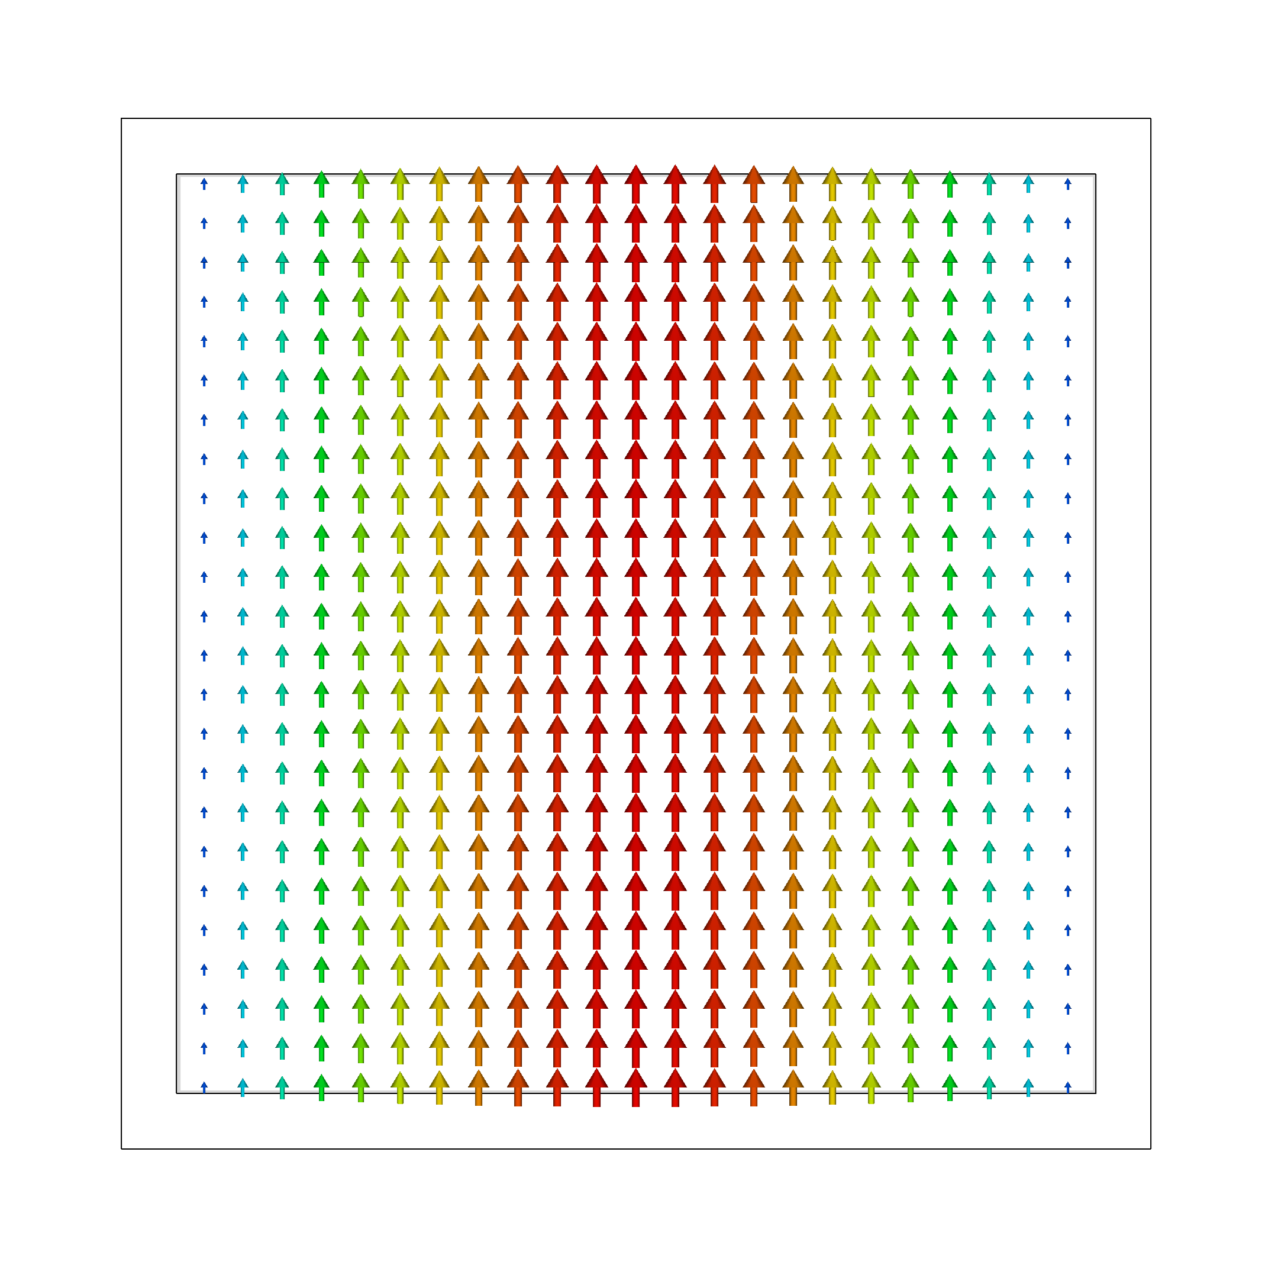
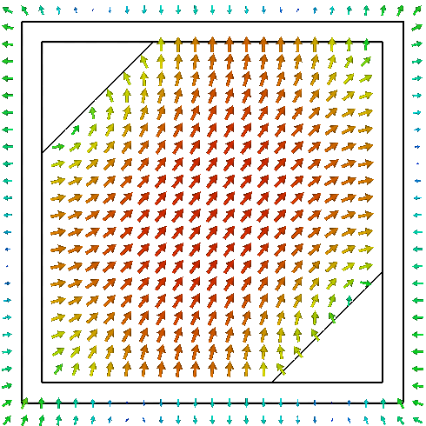
Polarizer: dual polarization

Slide 9
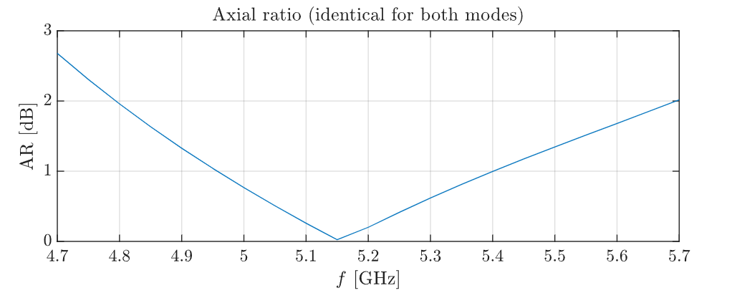
Polarizer: performance
Compact design
High polarization purity
Ease of fabrication
Dual polarization support

Slide 10
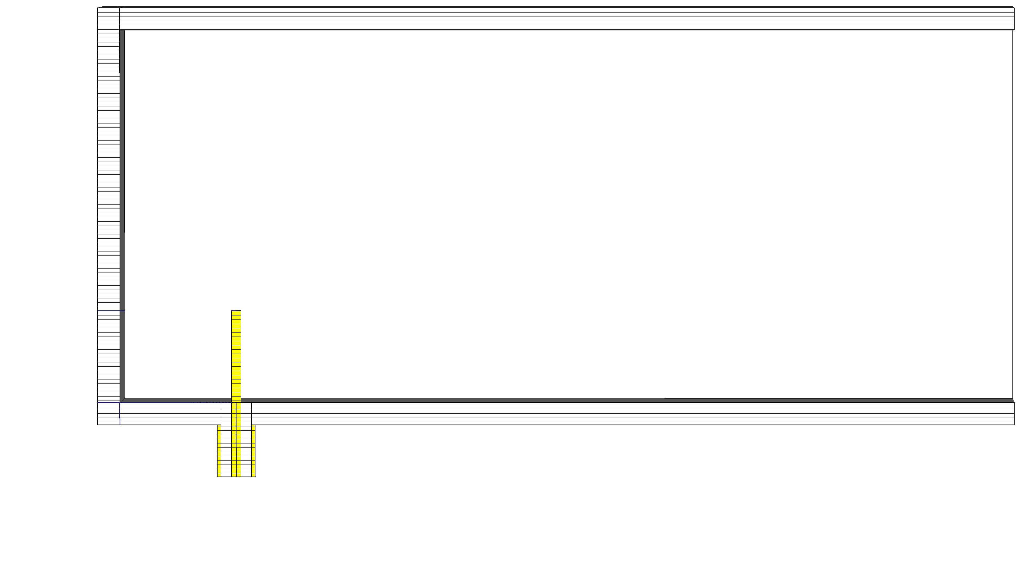
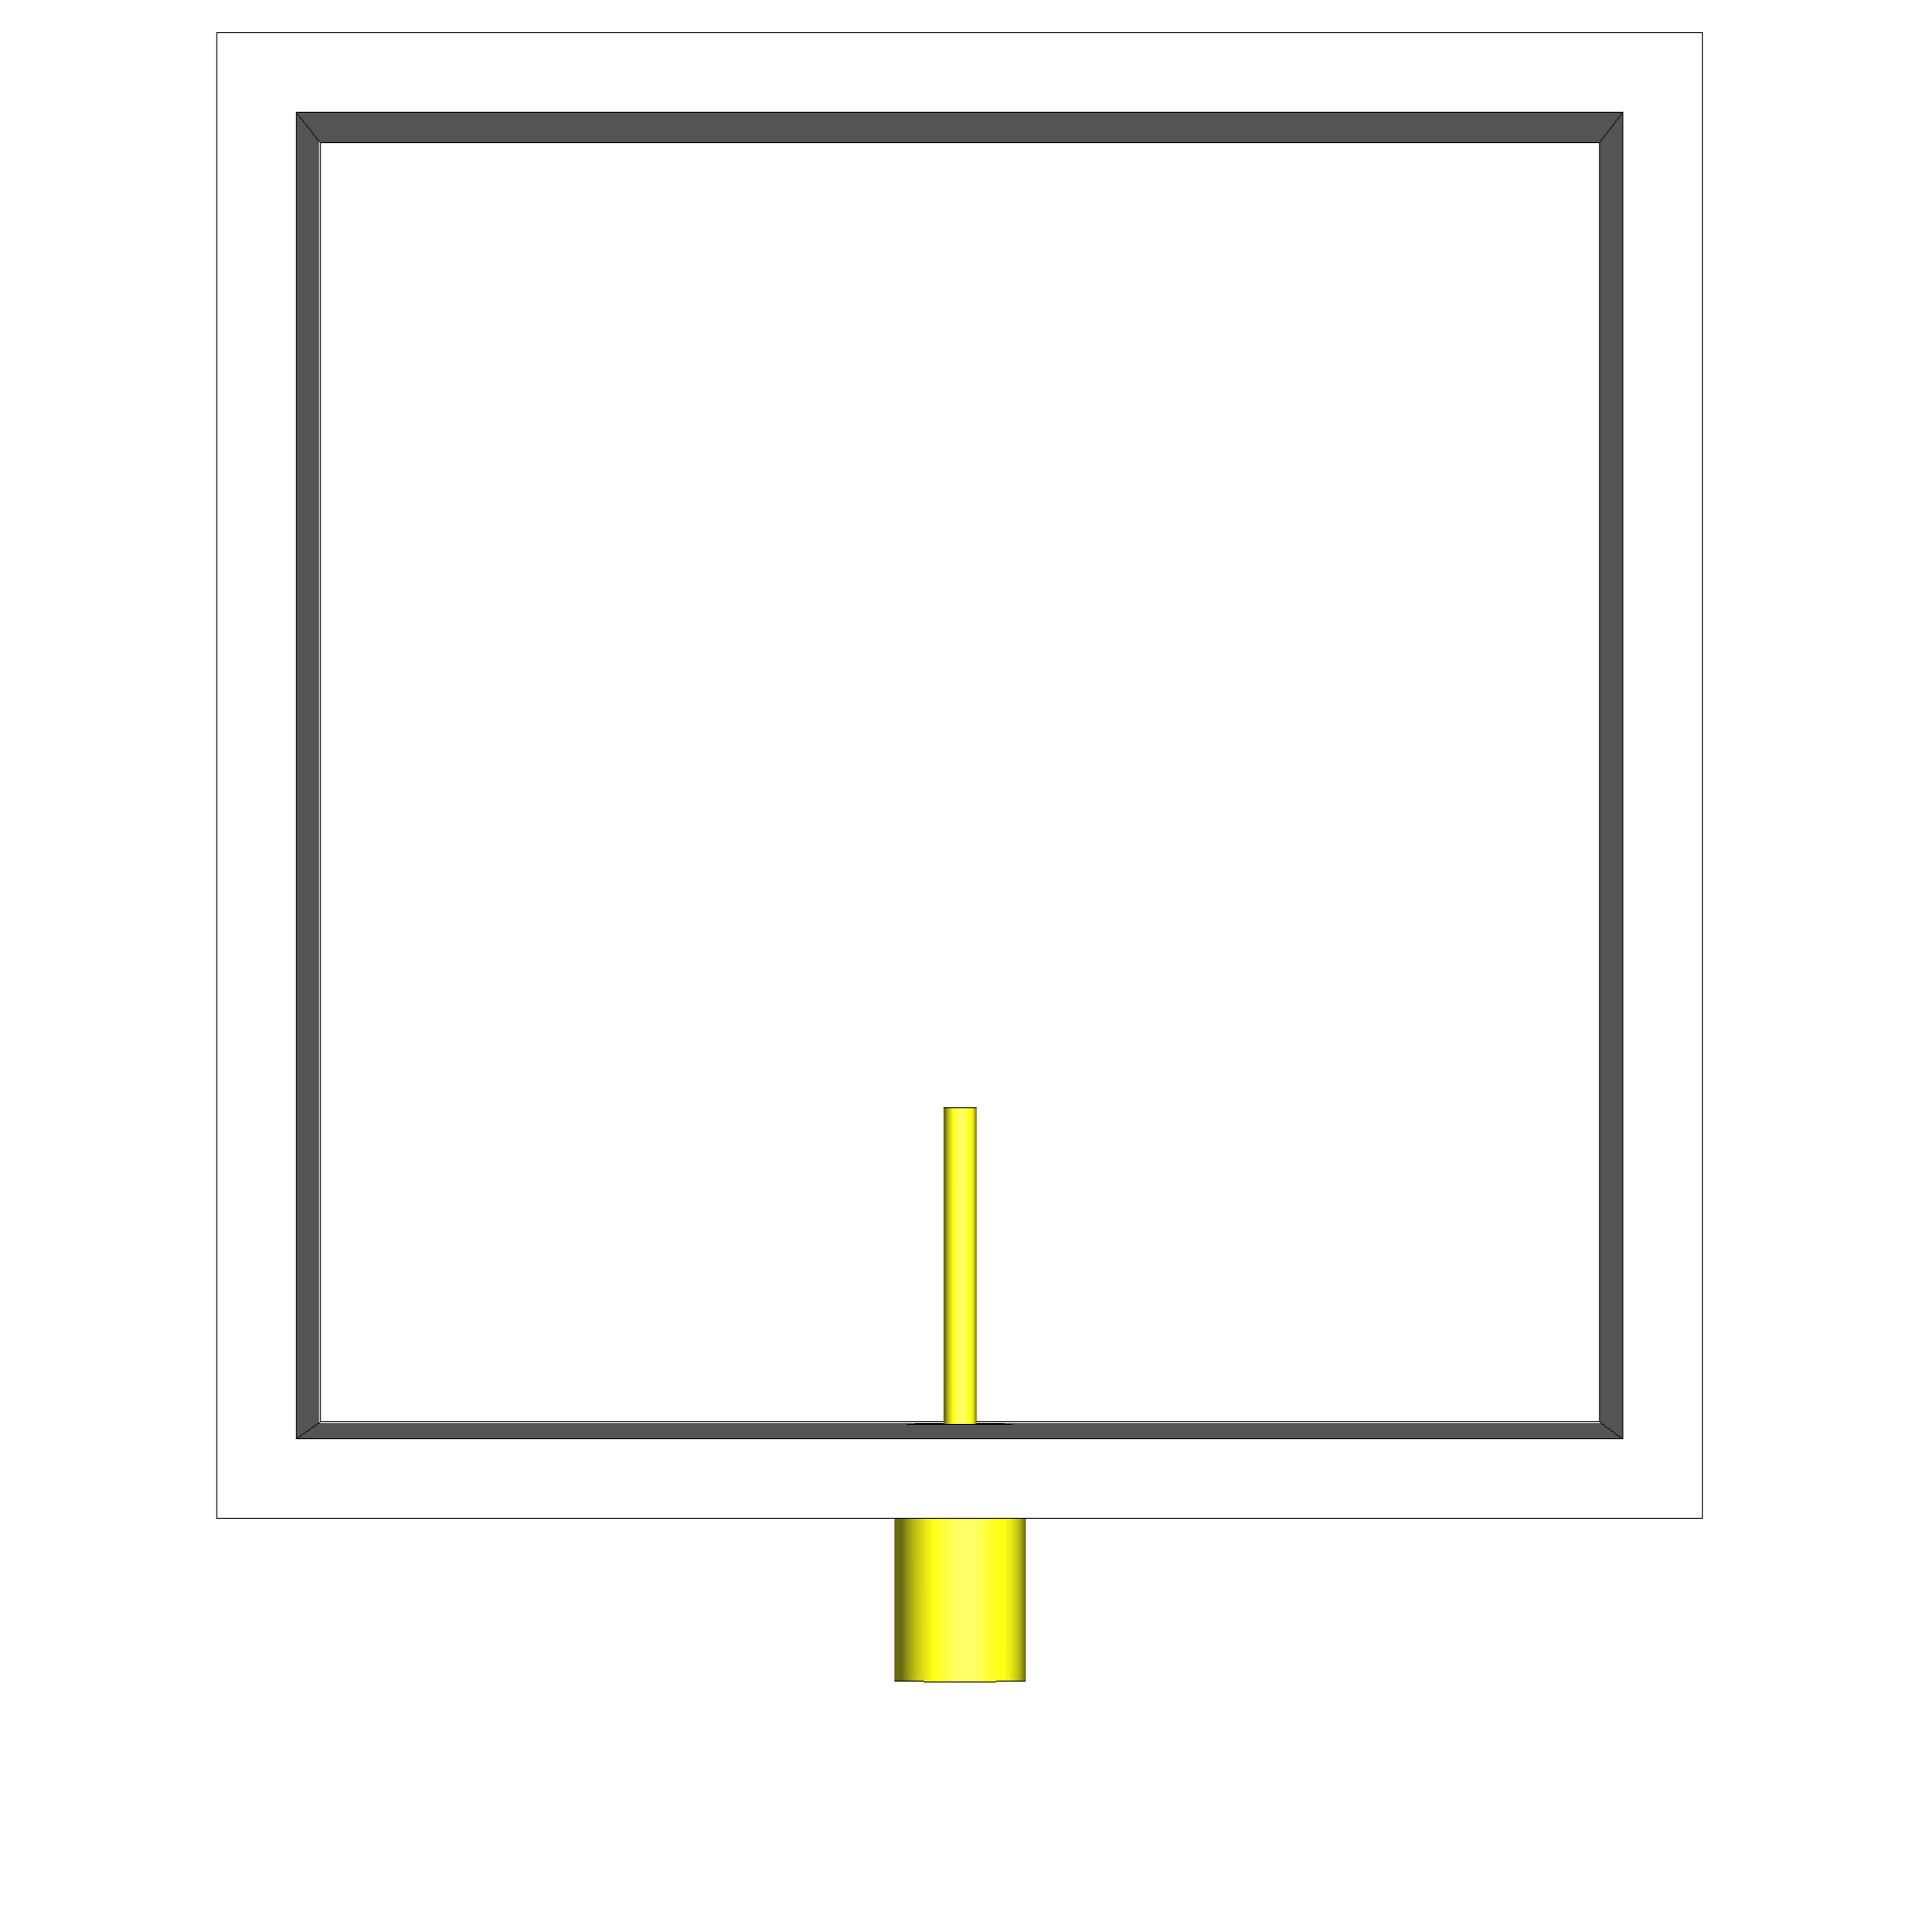
Dual feed: right-angle transition
Way to excite a waveguide mode
Important parameters: distance from the back-short

Slide 11
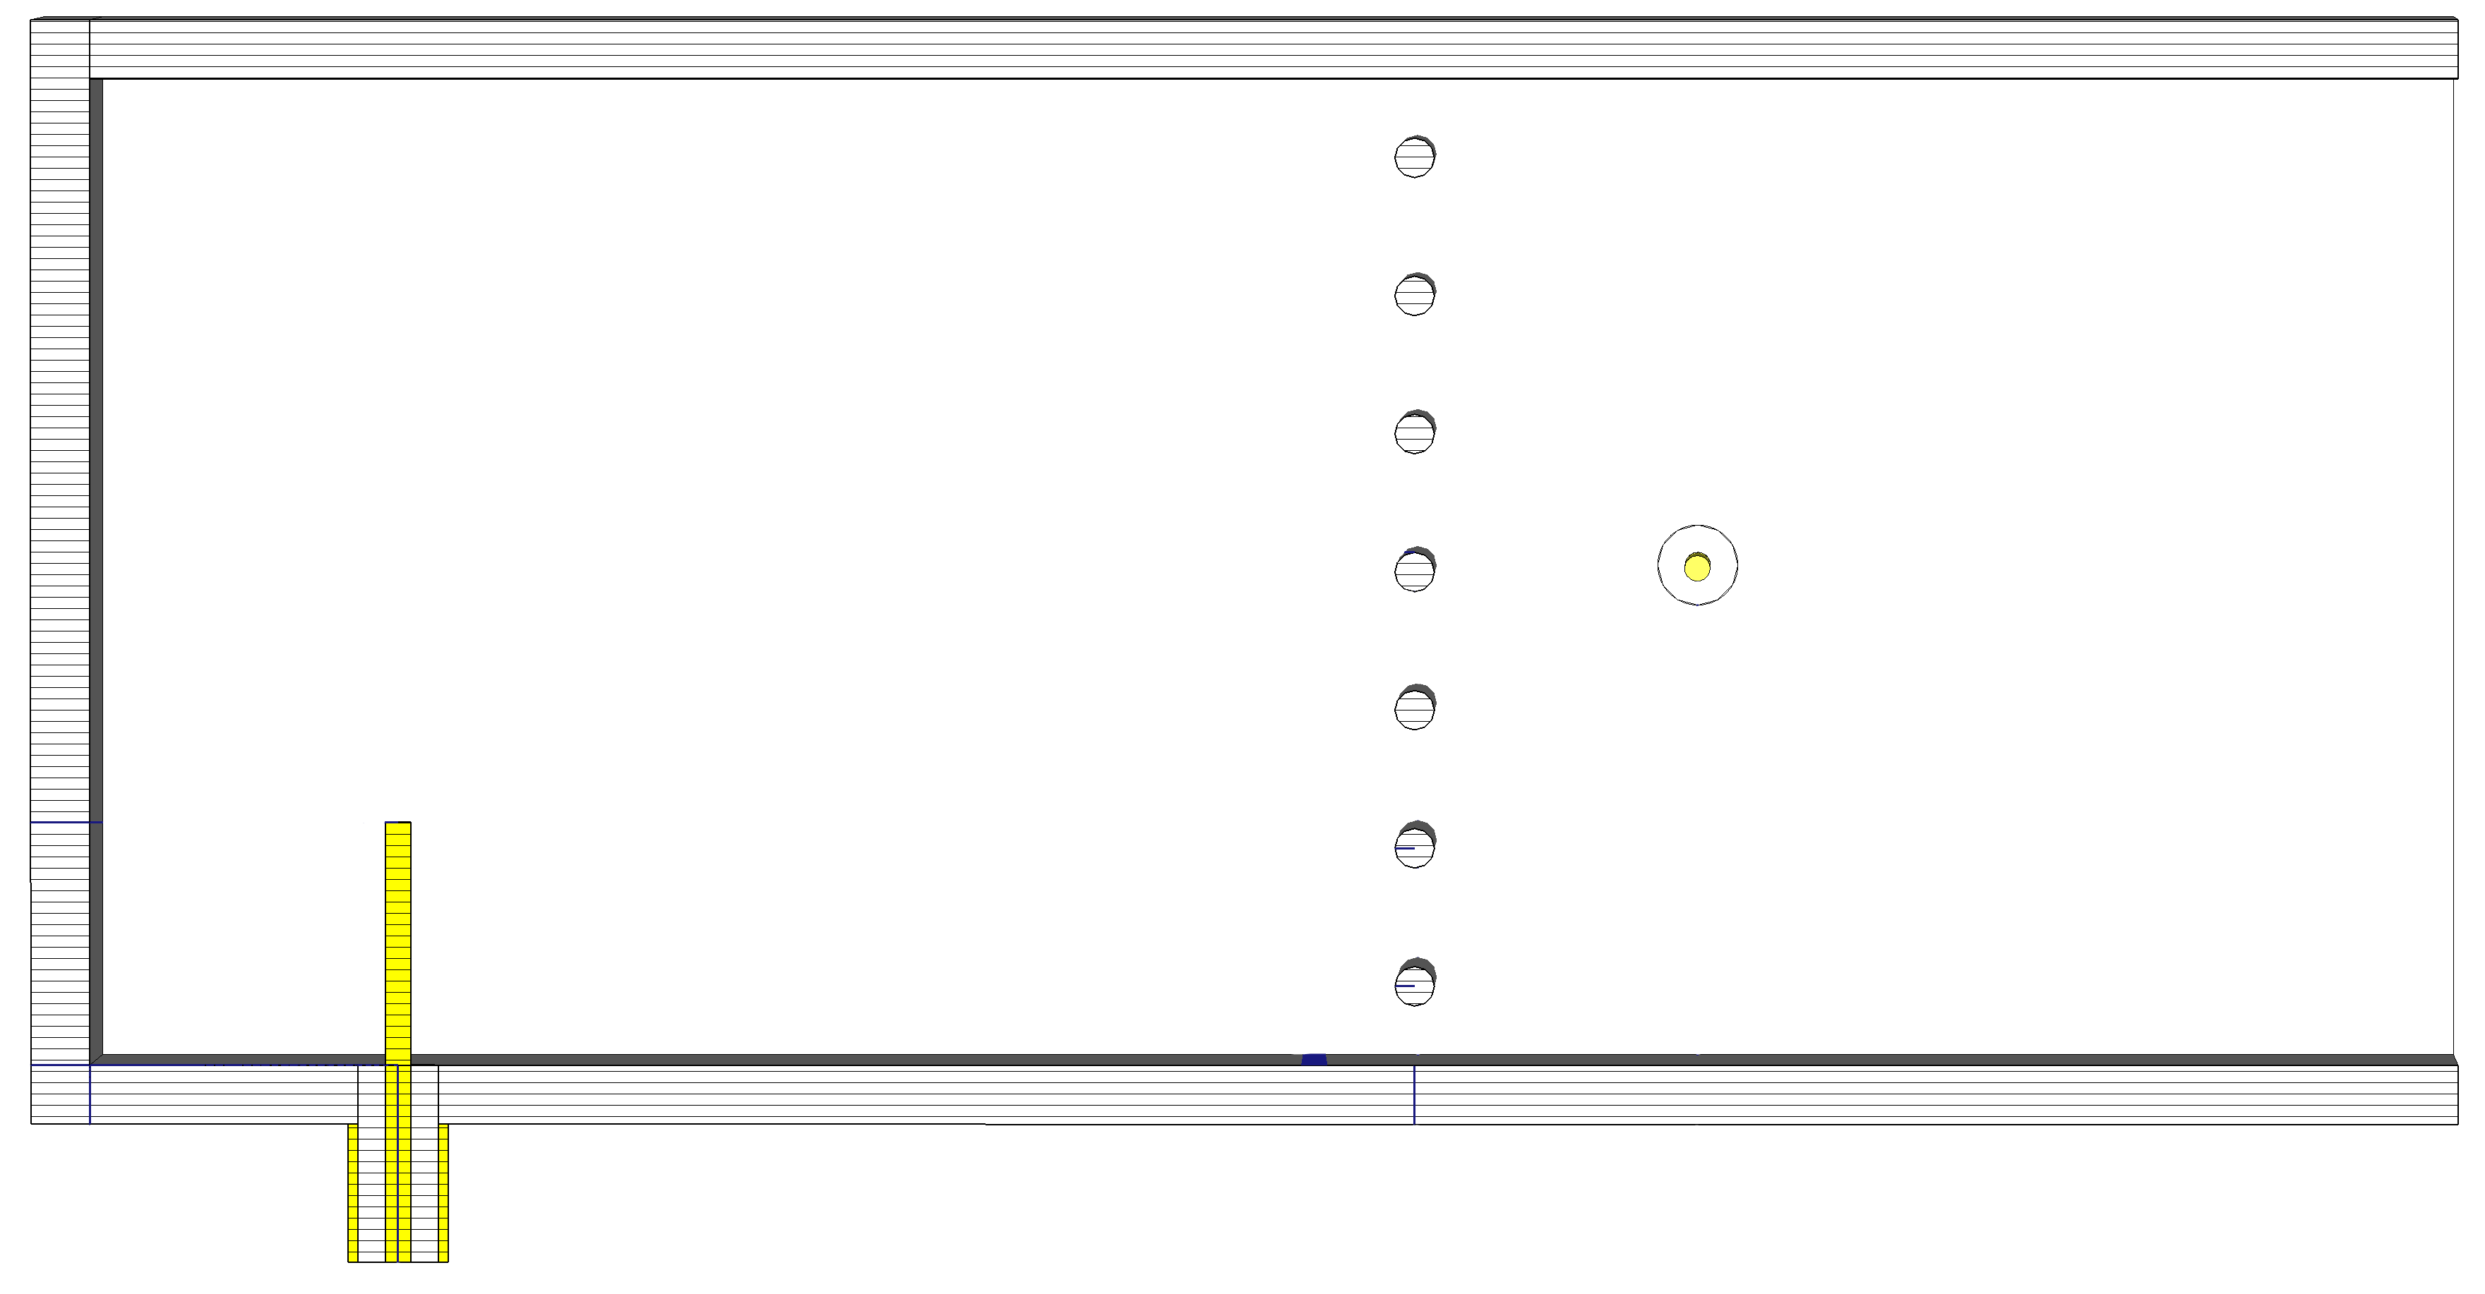
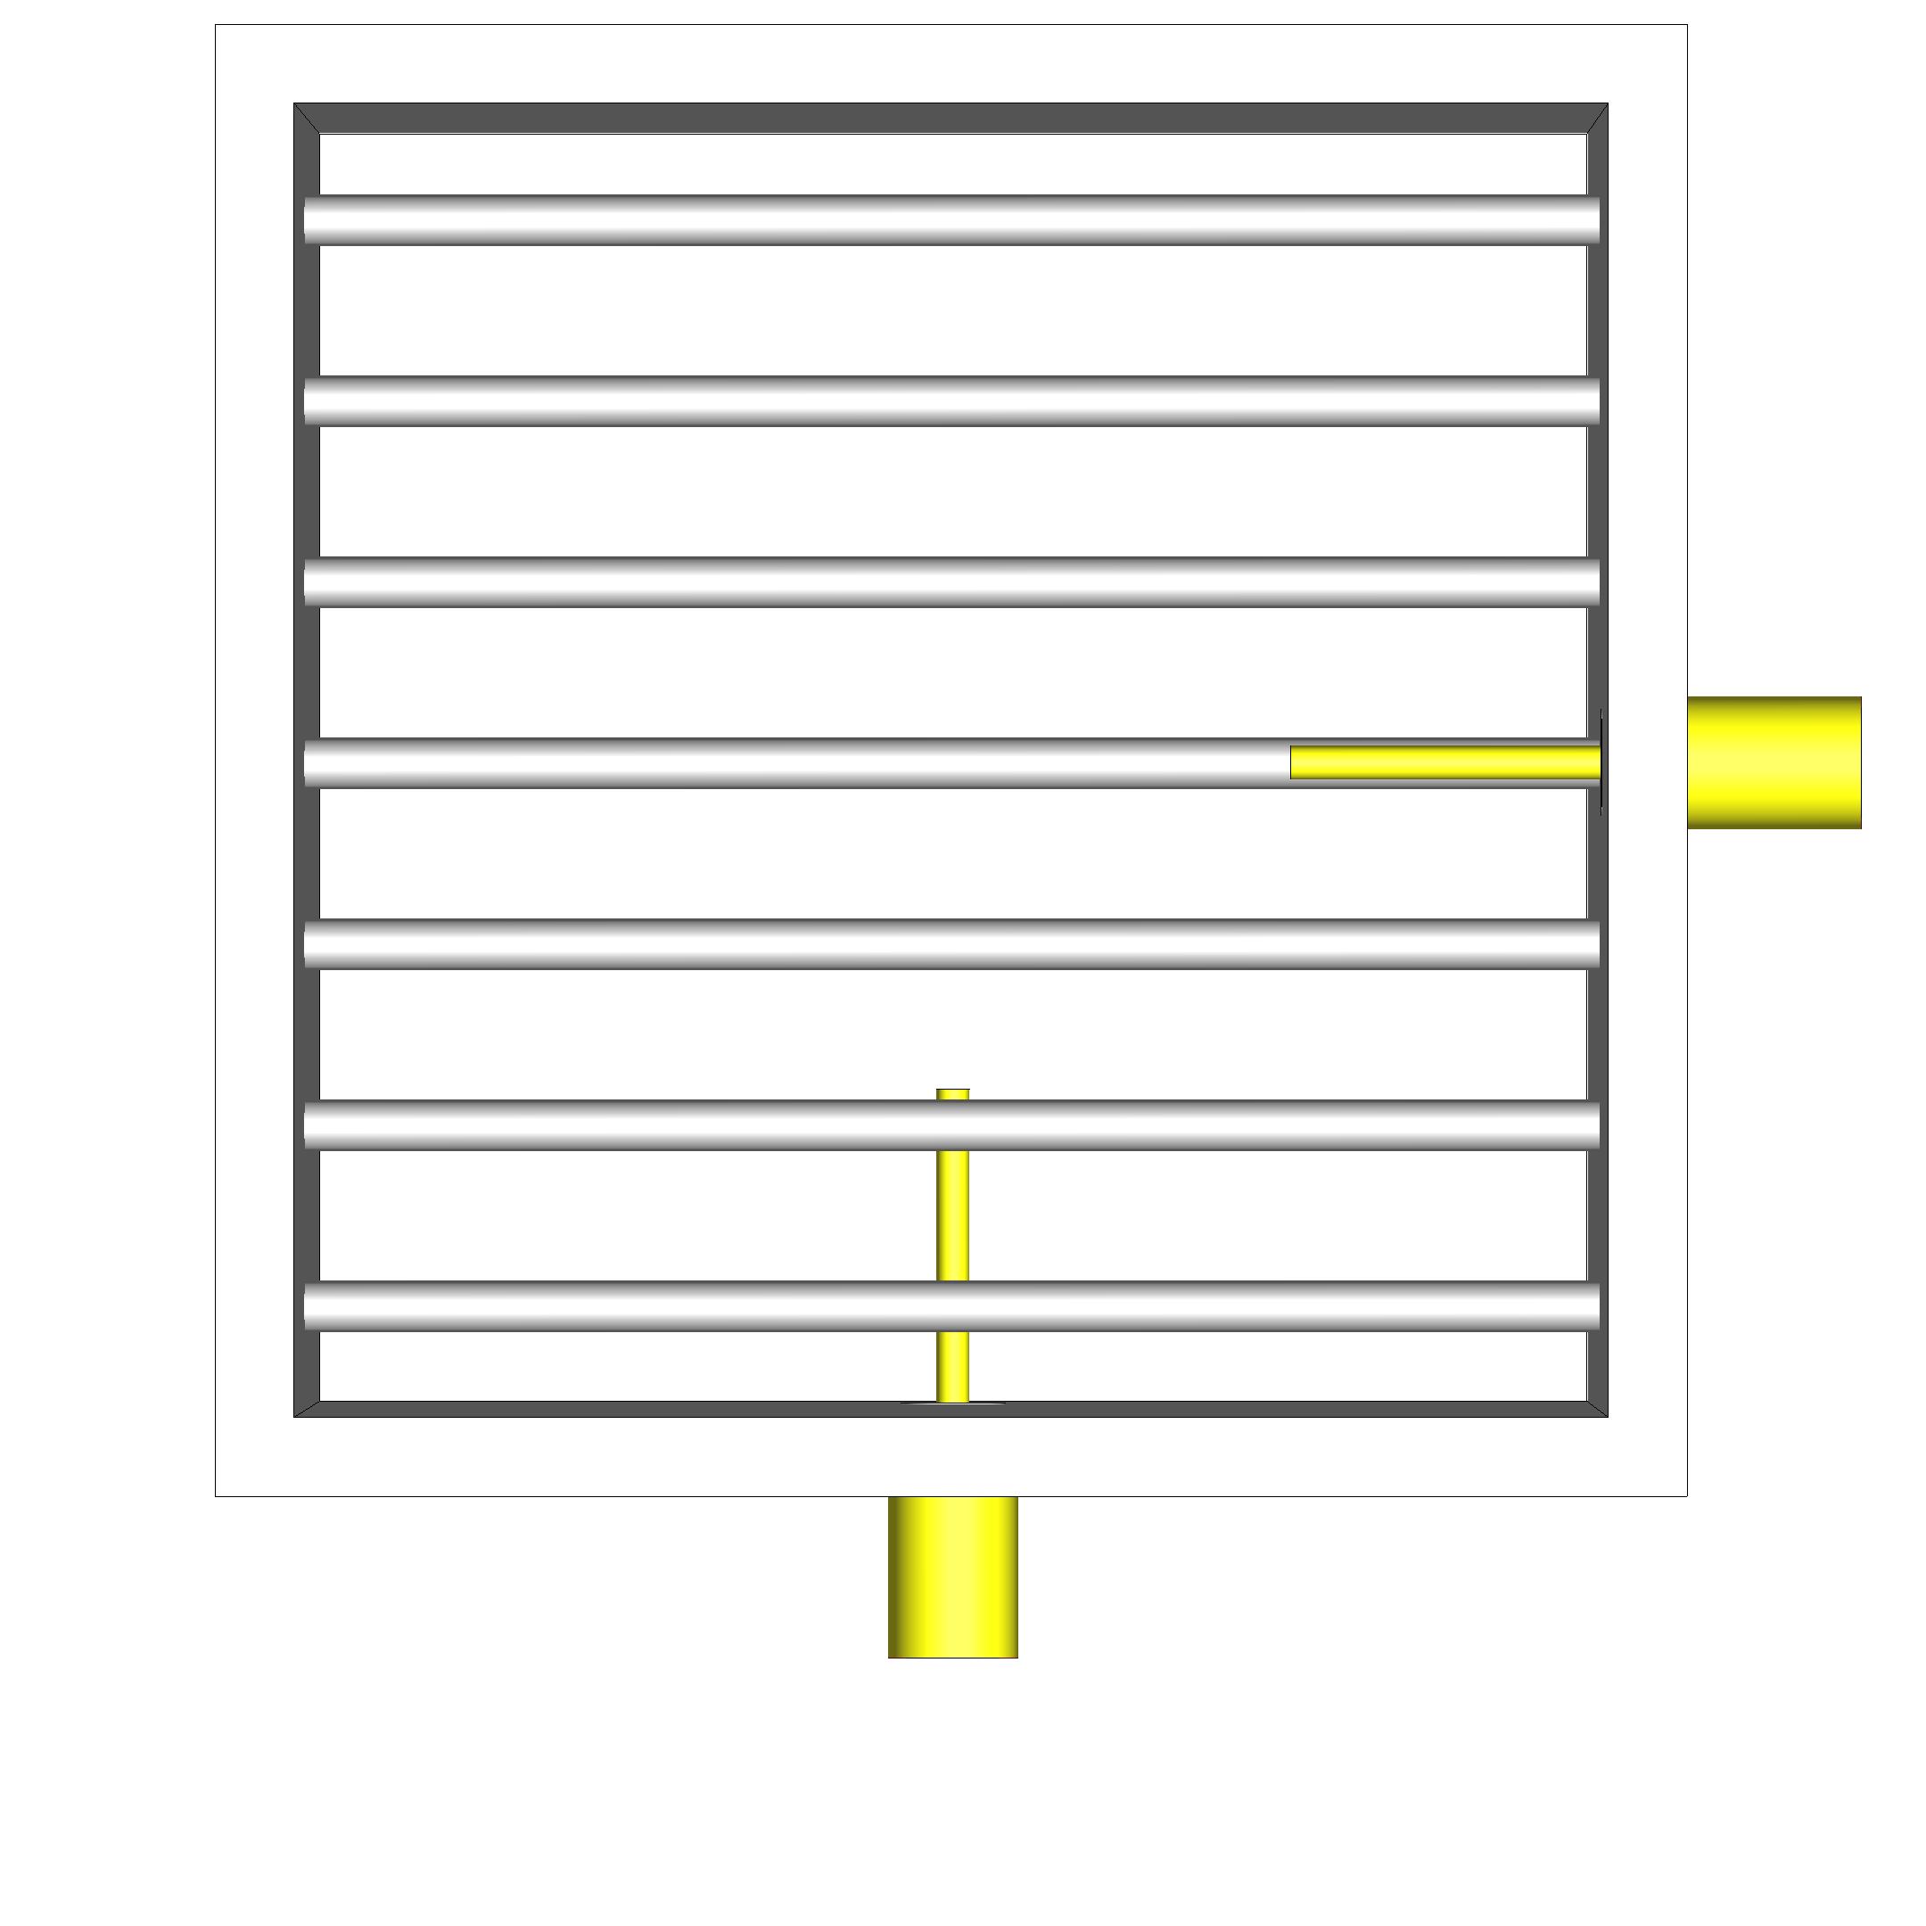
Dual feed: grating polarizer
Way to excite both waveguide modes
Grating polarizer as a back-short for the displaced port
Allows for port separation
Difficult optimization (constrained algorithm)

Slide 12
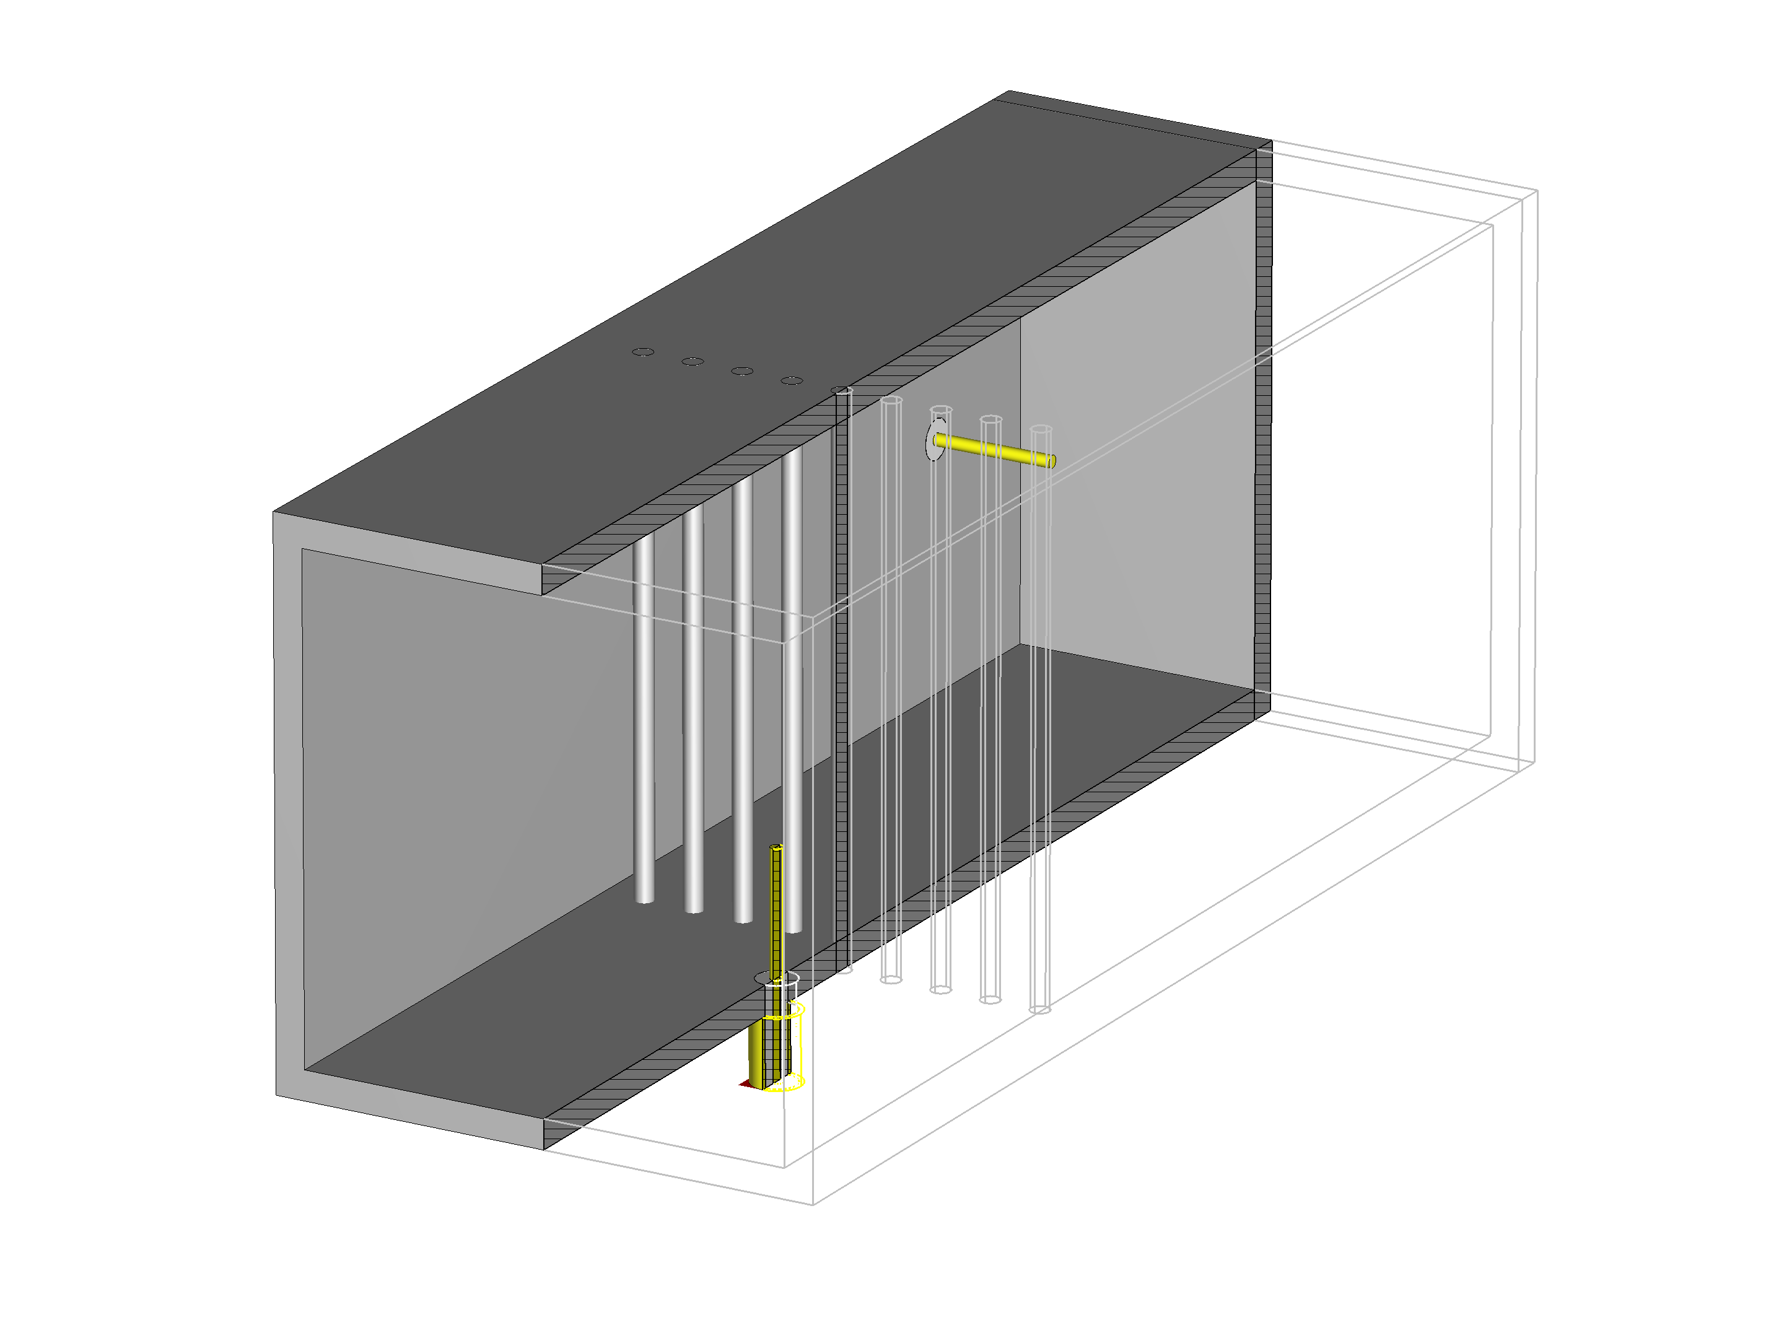
Dual feed: final model

Slide 13
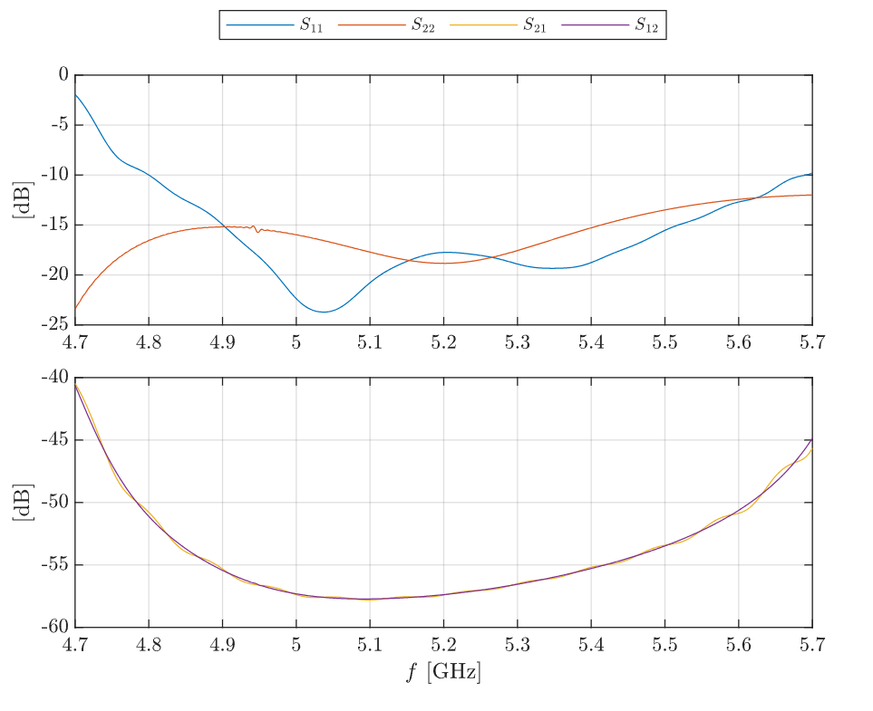
Dual feed: performance

Slide 14
Conclusion
Novel polarizer concept
Competitive polarization purity
Dual CP capability
Based on simple geometry
Dual feed designed
Excitation of two mutually orthogonal modes
Great cross-talk suppression
All objectives achieved with academic rigour

Slide 15
Thank you
for your attention

